Slide 1
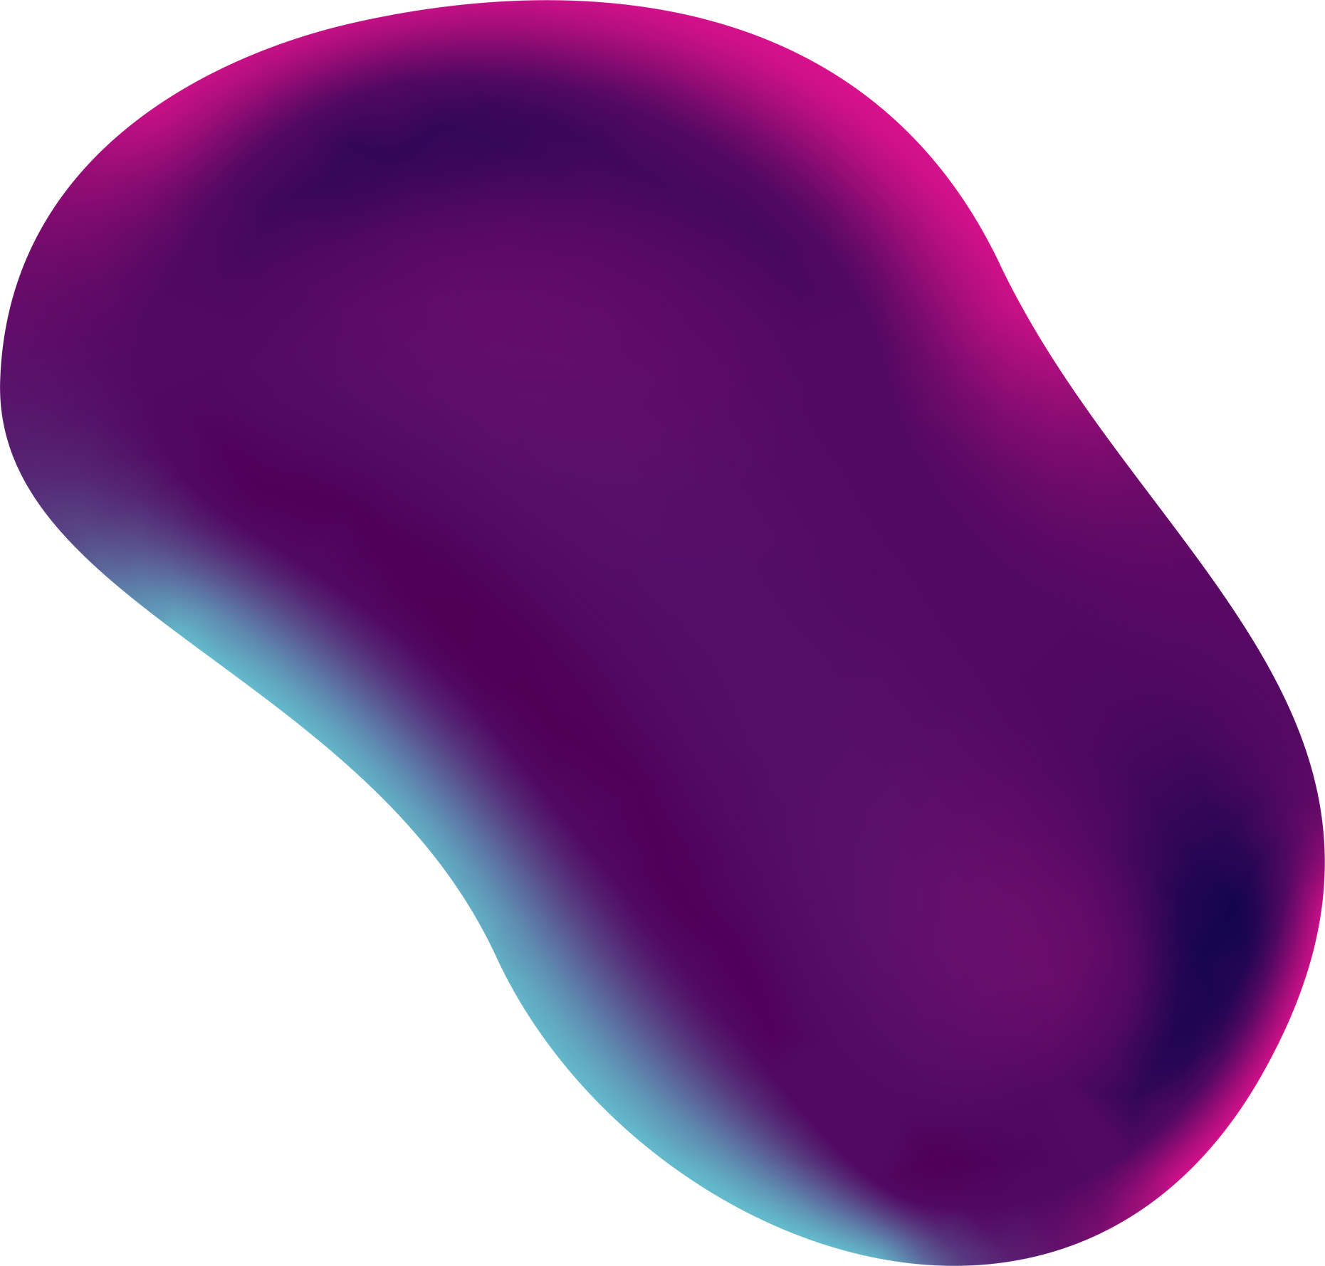


DEVELOPMENT OF ADVERTISEMENT RECOMMENDATION SYSTEM USING MACHINE LEARNING
PRESENTED BY
SUPRAJA MADALA
AMRUTH KUNTAMALLA

Slide 2


02
Presentation outline
Origin of the Idea​
Problem statement​
Solutions​
Model Usage​
Architecuture​
Future work​
Demo​
​

Slide 3


15
The Team
SUPRAJA MADALA
AMRUTH KUNTAMALLA

Slide 4
ORIGIN OF THE IDEA
The rapid growth of online advertising has made accurate ad recommendation and abnormal ad monitoring crucial. Machine learning, combined with AI, can achieve this through intelligent ad recommendation systems and abnormal ad monitoring systems.
These systems use data mining and real-time algorithms to deliver tailored ads and detect anomalies, improving the effectiveness of digital marketing strategies.

Slide 5

PROBLEM STATEMENT
Rapid growth of online advertising.
Difficulty in delivering relevant ads and monitoring anomalies.
Traditional methods are insufficient for large data volumes and content complexity.

Slide 6
SOLUTIONS
Evaluated Models:
We tested three machine learning models: Random Forest, Gradient Boosting, and Decision Tree. Initially, we implemented the Random Forest and Decision Tree models.
Initial Accuracy:
The Random Forest and Decision Tree models achieved 88% accuracy in predicting user clicks on ads. While effective, further analysis led us to explore a more powerful alternative.
Gradient Boosting Model:
Upon switching to Gradient Boosting, we saw a significant improvement in accuracy, reaching 93%. This model proved to be more effective for this dataset and task due to its ability to handle complex patterns.
Recommendation:
Given its superior performance and ease of interpretation, we recommend using the Gradient Boosting model to optimize ad targeting and improve prediction accuracy.
Notes:
In our advertisement recommendation system, we evaluated three different models: Random Forest Gradient boosting and Decision Tree. Initially, we implemented the Random Forest model & Decision tree, which yielded an accuracy of 88% in predicting user clicks on ads. After analyzing the results, we decided to switch to a Gradient Boosting model for comparison. ​
The Gradient Boosting model model outperformed the Random Forest & Decision tree achieving an accuracy of 93%. This improvement indicates that the Gradient Boosting model is more effective for this specific dataset and task. The simplicity of the Gradient Boosting model also allows for easier interpretation of the results. ​
Therefore, we recommend using the Gradient Boosting model for better performance in predicting advertisement clicks. This choice will likely enhance the effectiveness of our advertisement targeting strategy.​

Slide 7
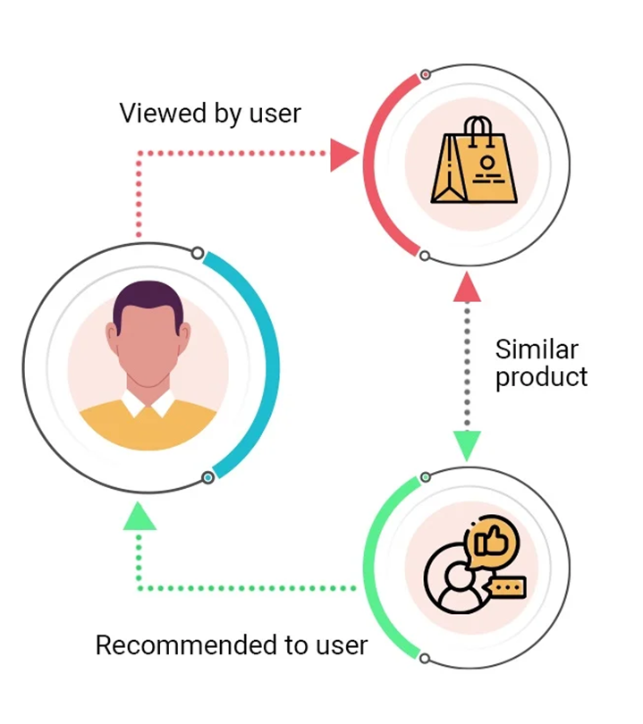
06
ARCHITECTURE

Slide 8
08
HOW IT WORKS
Data Collection (User Data + Ad Data)
Preprocessing (Cleaning and Preparing Data)
Model Training (Machine Learning)
Prediction (Ad Recommendation)
Github: https://github.com/amruth-k99/ad-recommendation

Slide 9




10
FUTURE OF AD RECOMMENDATION SYSTEMS
REAL-TIME
SMARTER
PRODUCTION-READY
Trends like real-time personalization, increased use of AI, and multi-channel recommendations.
Conten-based filtering, similar user based ads
Advanced Analytics DB integration and adjustments

Slide 10
THANK YOU

